Slide 1
ZOMATO RESTAURANT ANALYSIS Presentation
BY
RANAJOY DUTTA

Slide 2
AGENDA
Data Collection
Problem Statement
Analytical Approach and Tools
Objective key metrics and visualization
Strategic recommendation and dashboard

Slide 3
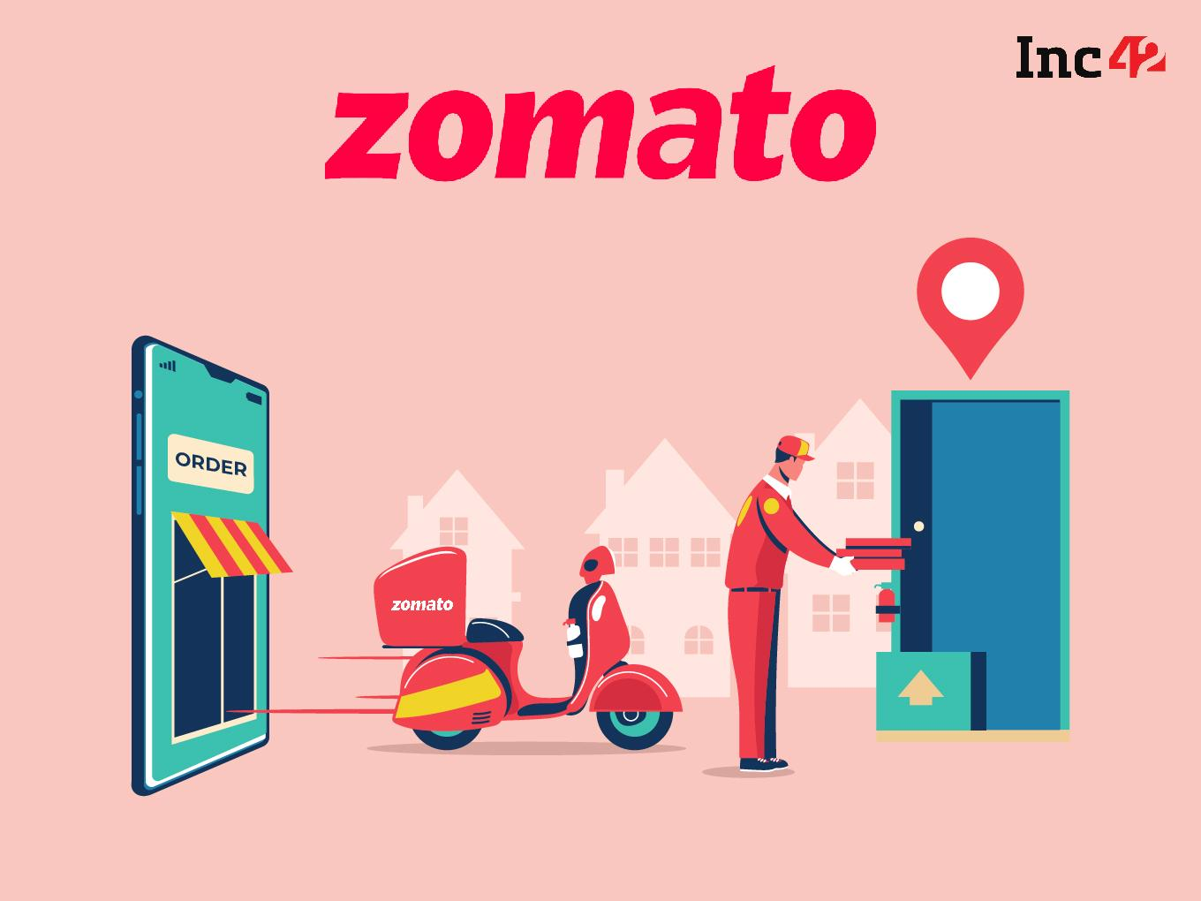

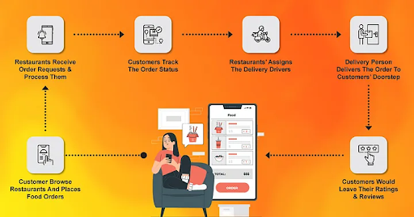
About
Zomato is one of the leading food delivery platform where people can search restaurants, search cuisines, order food to their door step, give review and upload photos of food and restaurants. It serves in more than 1000+ cities in India
Swiggy is another leading food delivery platform and the biggest competitor of Zomato in the current market which is founded in 2014. It serves in more than 580+ cities across India
Lets understand how Zomato works. The customers place order as per their choice from a restaurant, restaurants receives the request and process them, a delivery person assigned who delivers the order and allow customer to rate the food, restaurant and delivery person

Slide 4
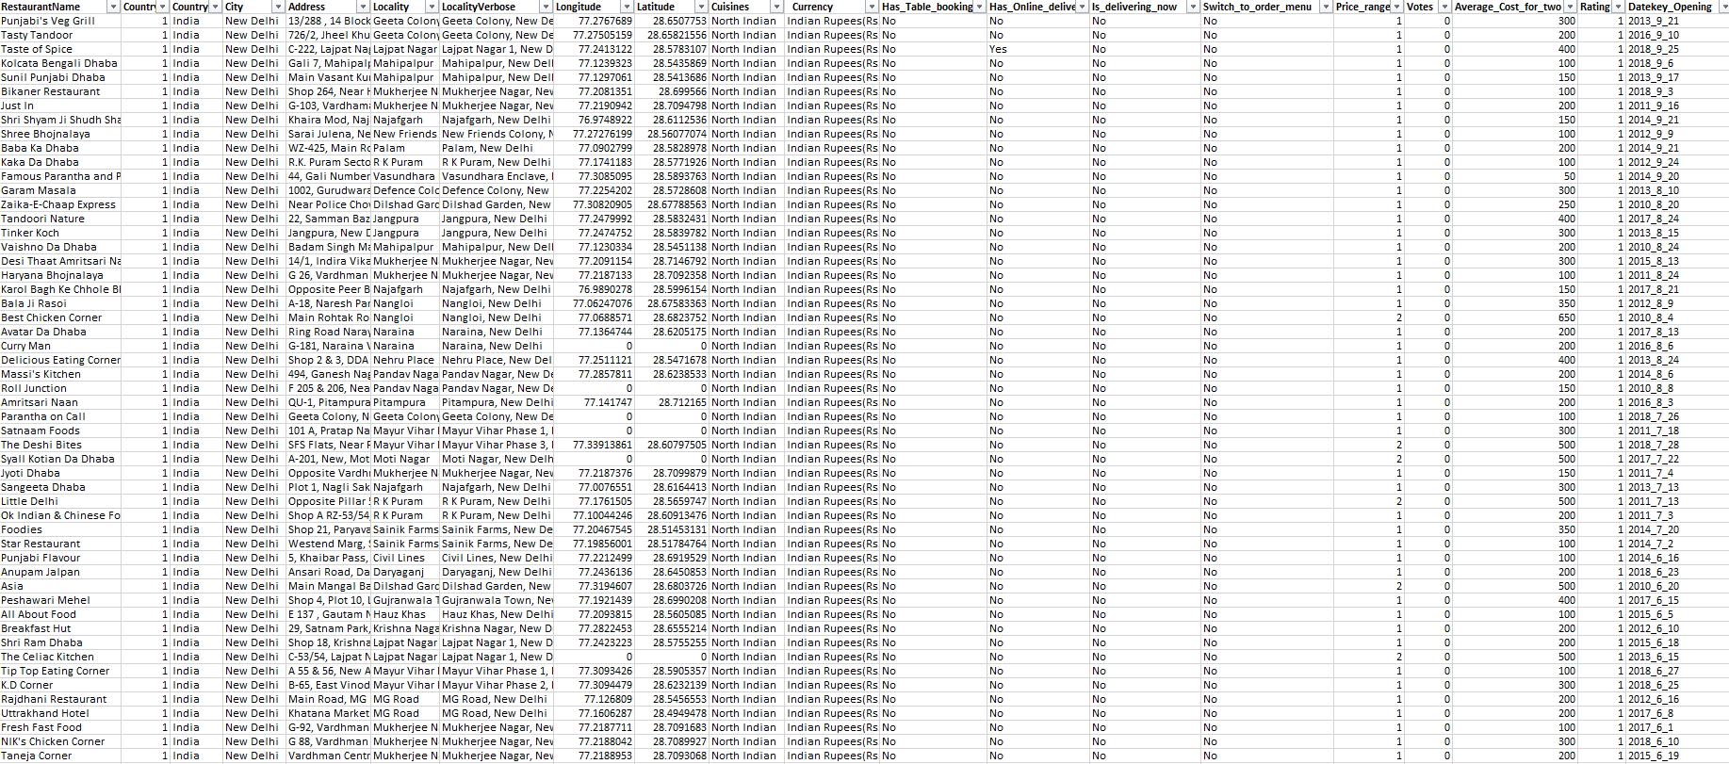
Problem statement
As a consultant data analyst in Zomato where the team is looking for expansion and opening more restaurants. Your task is to develop strategies/suggestions for opening newer restaurants.

Slide 5
Zomato data provided
Table 1- Raw Data
Restaurant ID: Unique identifier for each restaurant.
Restaurant Name: The name of the restaurant.
Country Code: Country code of the location where the restaurant is situated.
Country Name: The respective country for the given country code.
City: The city where the restaurant is located.
Address: The specific address of the restaurant.
Locality: The locality where the restaurant is situated.
Locality Verbose: Detailed information about the locality.
Longitude: The geographical longitude coordinate of the restaurant.
Latitude: The geographical latitude coordinate of the restaurant.
Cuisines: The type of cuisine offered by the restaurant.
Restaurant ID: Unique identifier for each restaurant.
Restaurant Name: The name of the restaurant.
CountryCode: Country code of the location where the restaurant is situated.
Country Name: The respective country for the given country code.
City: The city where the restaurant is located.
Address: The specific address of the restaurant.
Locality: The locality where the restaurant is situated.
Locality Verbose: Detailed information about the locality.
Longitude: The geographical longitude coordinate of the restaurant.
Latitude: The geographical latitude coordinate of the restaurant.
Cuisines: The type of cuisine offered by the restaurant.

Slide 6
Zomato data provided
Table 2- Raw Data
Table 3- Suggested Countries
Country Code: The code assigned to a specific country that helps identify the country in raw data.
Country Name: The respective country for the given country code.
Conversion Rates to Rs.: Currency conversion rates to Rs.
Restaurant ID: Unique identifier for each restaurant.
Restaurant Name: The name of the restaurant.
CountryCode: Country code of the location where the restaurant is situated.
Country Name: The respective country for the given country code.
City: The city where the restaurant is located.
Cuisines: The type of cuisine offered by the restaurant.
Has_Table_booking: Indicates whether the restaurant has a table booking option (Yes/No).
Has_Online_delivery: Indicates whether the restaurant offers online delivery (Yes/No).
Average_Cost_for_two: The average cost for two people dining at the restaurant.
Votes: The number of votes or ratings/(feedback) received by the restaurant.
Rating: The overall rating of the restaurant is based on user reviews.

Slide 7


ANALYTICAL APPROACH AND TOOLS
Ensuring data accuracy using functions like TRIM, Remove Duplicate
Using of VLOOKUP for reference additional data source to enhance data set
Analyzing Restaurants with high rating but do not have delivery option using IF, AND functions
Created Pivot Tables to outline the relation between Countries, Ratings, Votes, Cuisines to identifying patterns across different Cities and Restaurants
Used SLICERS to filter data in Pivot Tables and Pivot Charts to display specific set of data
Created Charts and Dashboards for visual representation of data

Slide 8
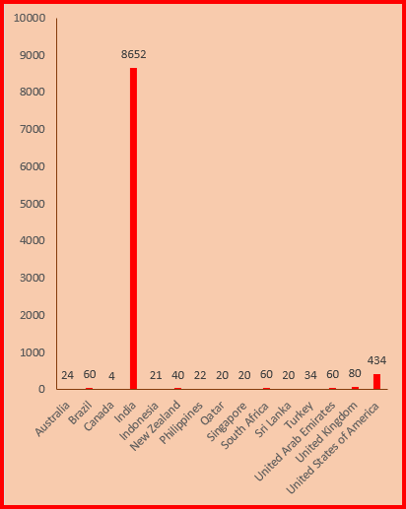
Number Of Restaurants Opened In Each Country
India has the majority of the total restaurants with 8652, which is about 90.55% of the total.
United States of America has the significant count of restaurant with 434, which is still less than average count of restaurant 636.
Data shows very low count of restaurants in popular tourist destinations like Australia, Canada, Singapore, United Arab Emirates and United Kingdom.
Considering opening new restaurants in popular tourist countries

Slide 9
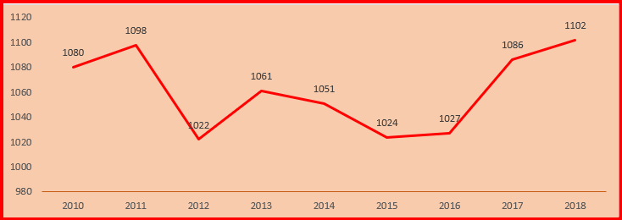
NUMBER OF RESTAURANTS OPENED IN EACH YEAR
We have a line chart for number of restaurants opened in the suggested countries by year.
We can see that new restaurant openings peeked in the recent year 2018 with 1102 restaurants opened in a single year.
We can see after 2011 new restaurant opening took a huge downfall.
After, 2016 we are seeing a solid growth in new restaurant opening and it is expected to continue, we should focus on getting on this trend while its positive and open new restaurants

Slide 10
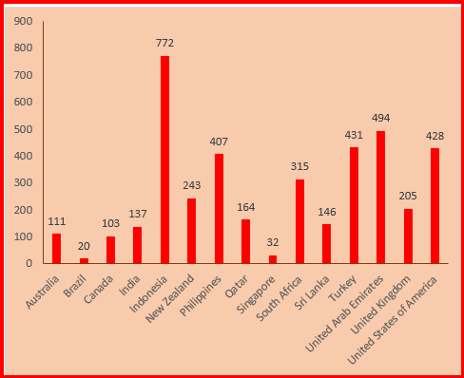
Average Voters In Each Country
Evaluated operational aspects such as the average number of voters for restaurants in countries, providing a comparative analysis of customer engagement.
Indonesia has the highest number of voters. Even after being a less population country and less number of restaurant present.
Brazil and Singapore has the lowest number of voters with only 20 & 32 average voters respectively.
We can see that even India has the highest number of restaurants with very high population, the number of voters are very less.

Slide 11
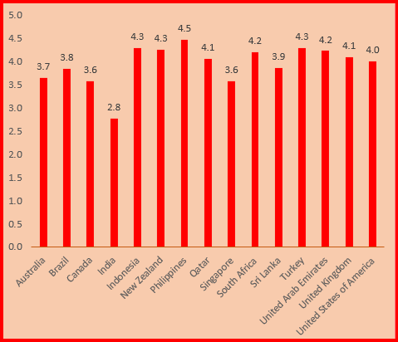
Average Rating Of Restaurants In Each Country
Utilized statistical methods to calculate critical metrics such as average ratings for guiding operational improvements and strategic adjustments.
We can see that Phillippines has high rated restaurants with average rating of 4.5
India has the lowest rated restaurants with average of 2.8
Indonesia, New Zealand and Turkey has the same average rating of 4.3
Less average ratings mean that there is a scope for improvement in cuisines, quality, service, ambiance
Even with high average food expenditure, they have restaurants with ordinary quality.

Slide 12
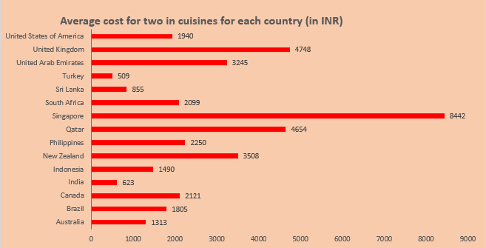
Average cost for two for each country (in INR)
We can see that Singapore has highest average expenditure for two i.e. Rs. 8442 followed by United Kingdom i.e. Rs. 4748
Turkey has the lowest average expenditure on food i.e. Rs. 509 only.

Slide 13
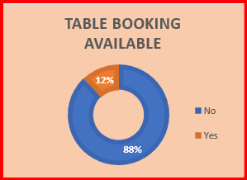
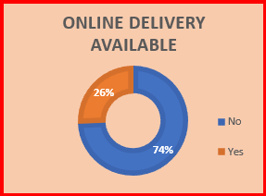
Has Table Booking
RESTAURANTS HAS TABLE BOOKING AND ONLINE DELIVERY
Total of 88% of restaurants don’t have table booking option.
Total of 74% of restaurants don’t offer online delivery.
But we found that few countries not even has one restaurant offer online delivery or table booking
There is a great scope of improvement if we start online delivery and table booking features.
We can easily capture the market by doing this as it will make customer experience easier.
No: 8393
Yes: 1158
Has Online Delivery
No: 7100
Yes: 2451

Slide 14
SUGGESTED COUNTRIES
SUGGESTED CITIES
Suggested Countries: Australia, Canada, Singapore, United Arab Emirates and United Kingdom
Data shows very low count of restaurants in popular tourist destinations like Australia, Canada, Singapore, United Arab Emirates and United Kingdom.
The number of restaurants opened In these countries are very less in past few years
Australia, Canada, Singapore has very less rated restaurants hence there is chance of improvement
Non of the country Australia, Canada, Singapore offer table booking and online delivery
United Kingdom does offer Table booking but only 15% and don’t offer any online delivery
Suggested cities in australia : Victor Harbor, Phillip Island, Lakes Entrance, East Ballina, Inverloch
Suggested cities in Canada: Chatham-Kent, Consort, Vineland Station, Yorkton
Suggested cities in Singapore: Singapore City
Suggested cities in United Arab Emirates: Dubai, Abu Dhabi
Suggested cities in United Kingdom: Birmingham, London, Manchester

Slide 15
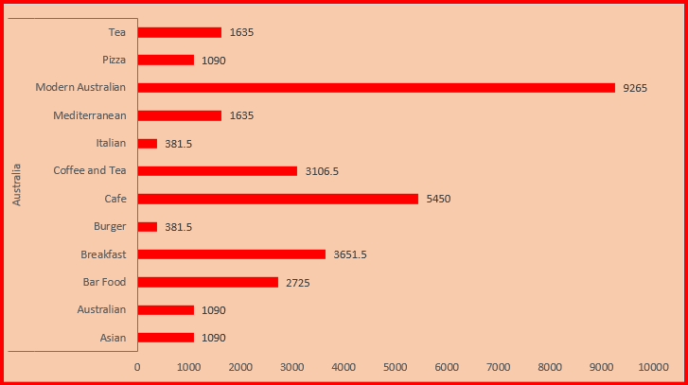
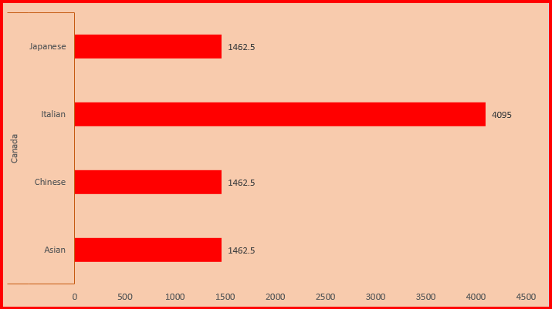
CUISINES NEED TO FOCUS ON SUGGESTED COUNTRIES
Cuisines are one of the most important factor when considering to open a restaurant.
We can consider maximum spending on a cuisine by sum of average spending by two.
Most amount spent on a cuisine is most popular in that country
In Australia, Modern Australian food is most popular followed by Café.
In Canada, Italian cuisine is most favorable.

Slide 16
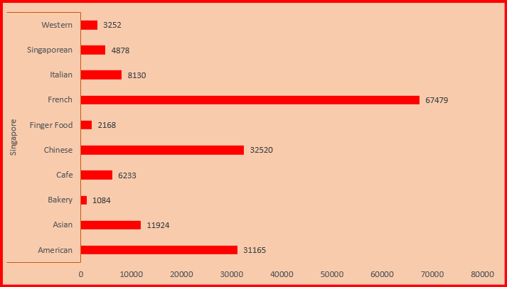
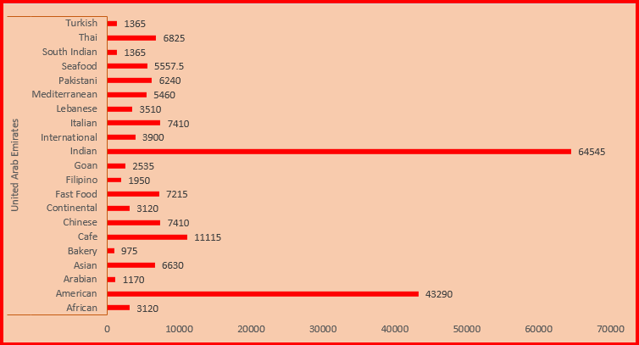
Cuisines Need To Focus on Suggested Countries
In Singapore, Modern French food is most popular followed by Chinese and American are equally popular.
In United Arab Emirates, Indian cuisine is most favorable followed by American.

Slide 17
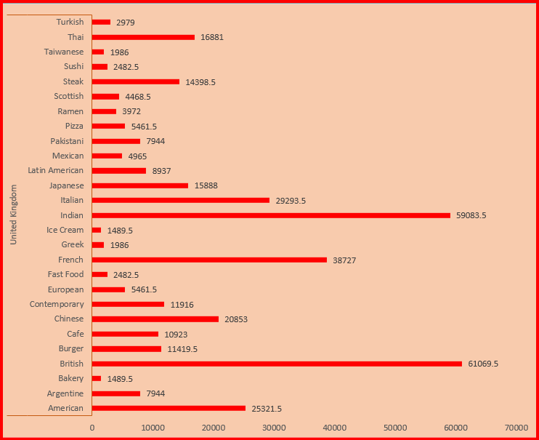
CUISINES NEED TO FOCUS ON SUGGESTED COUNTRIES
In United Kingdom we can see various cuisines are popular such as Indian and British are equally favorable with highest spending by two
French and American cuisines are also gaining popularity in the country.

Slide 18
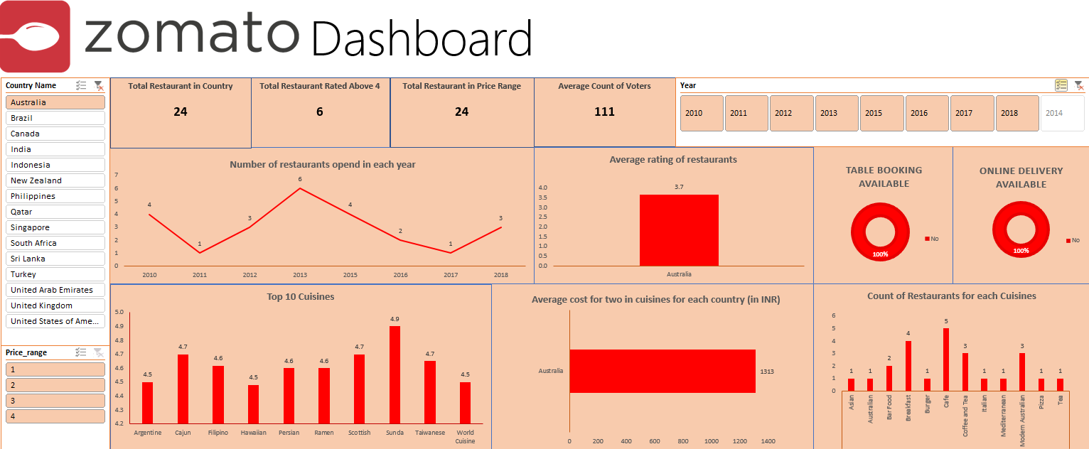

Slide 19



Conclusion
On the basis of above analysis here I can conclude that there are many possibilities of expansion and opening more restaurants in some countries and cities.
I will suggest Australia, Canada, Singapore, United Arab Emirates and United Kingdom countries where we can expand more restaurants.
The reason for selecting above mentioned countries because they are very popular tourist destinations and has a very less count of restaurants which means very less competition.
Analyzed other factors also to determine which country we can expand and open more restaurants like which cuisines are mostly liked, is the restaurant offer online table booking and delivery option, average cost spend for two, rating of the restaurants, etc.

Slide 20
Thank you
BY: RANAJOY DUTTA
ranajoy8004@gmail.com

